Slide 1
IMDB TOP 1000 MOVIES
By: Rachel Conca, Dan Do, Liam Keblin, Lucas Lamenha, Aravind Sathappan

Slide 2
About the dataset
We chose to use a dataset of the top 1000 grossing movies on IMDb
The different characteristics of the dataset include:
The name of the movie
The year the movie released
The certificate earned by the movie
The total runtime of the movie
The meta score the movie received
The name of the director and star actors/actresses in the movie
The total number of votes on the movie
And the amount of money earned by the movie.

Slide 3
What we were trying to find
The main problem our group tried to solve was what are the most important factors that go into top grossing movie.
We ran many tests to find which characteristics were most important to have for a successful movie.

Slide 4
Machine Learning Models we used
Linear Regression - We started this start to establish a baseline model, assuming a linear relationship between movie features and IMDB ratings.
Polynomial Regression - We thought that If linear regression underfits, we can make it polynomial to capture the nonlinear predictors. There may be a risk of overfitting if there are too many predictor variables.
Decision Trees- We decided to use decision trees to identify significant variables and relationships between two or more variables. If a data scientist is working on a problem with hundreds of variables, the decision tree will help identify the most significant ones.

Slide 5
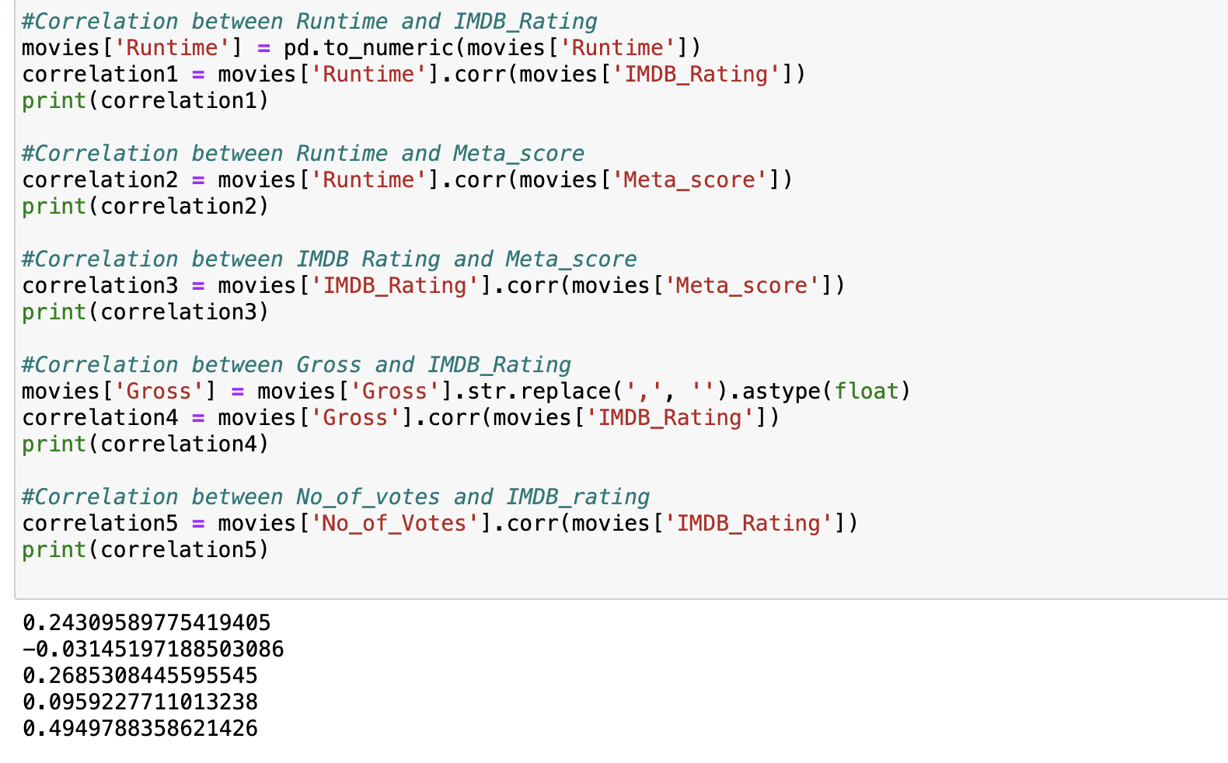
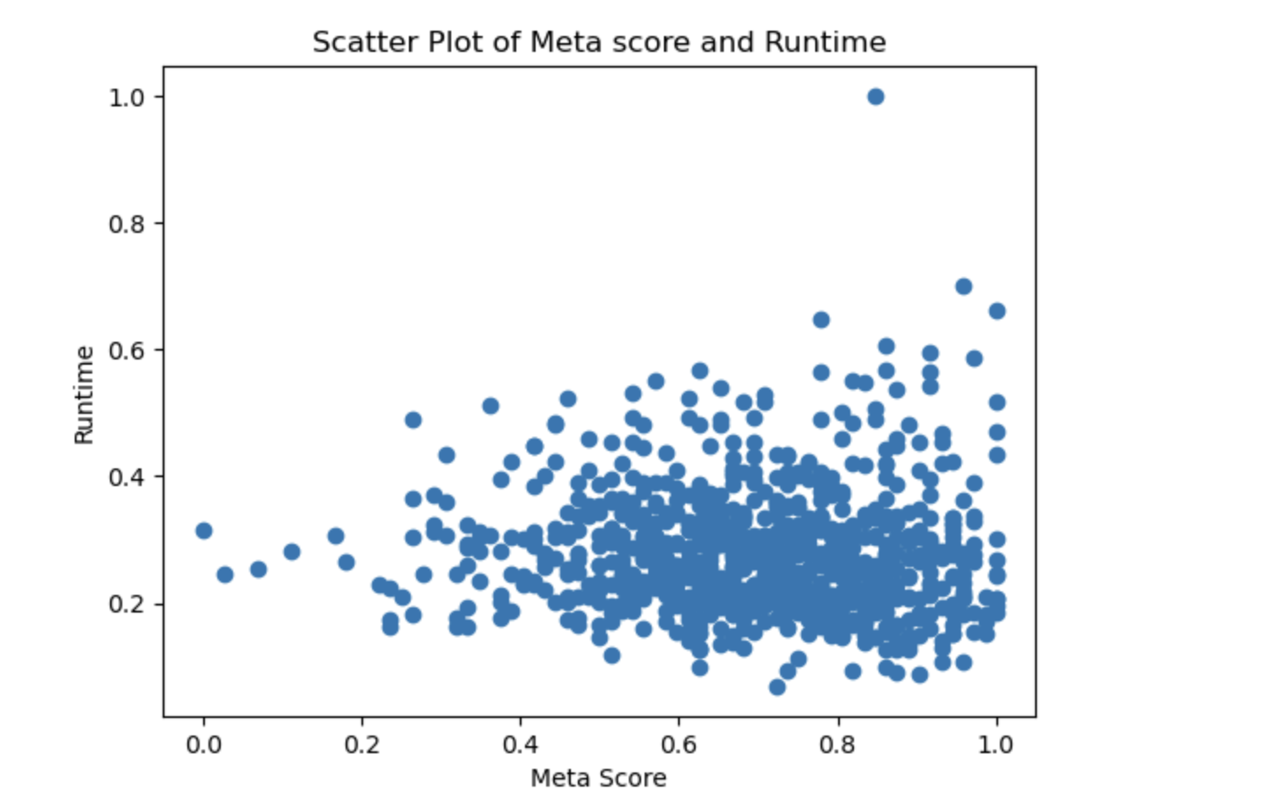
Correlations between columns
Notes:
There is a slightly negative correlation between Meta Score and Runtime

Slide 6
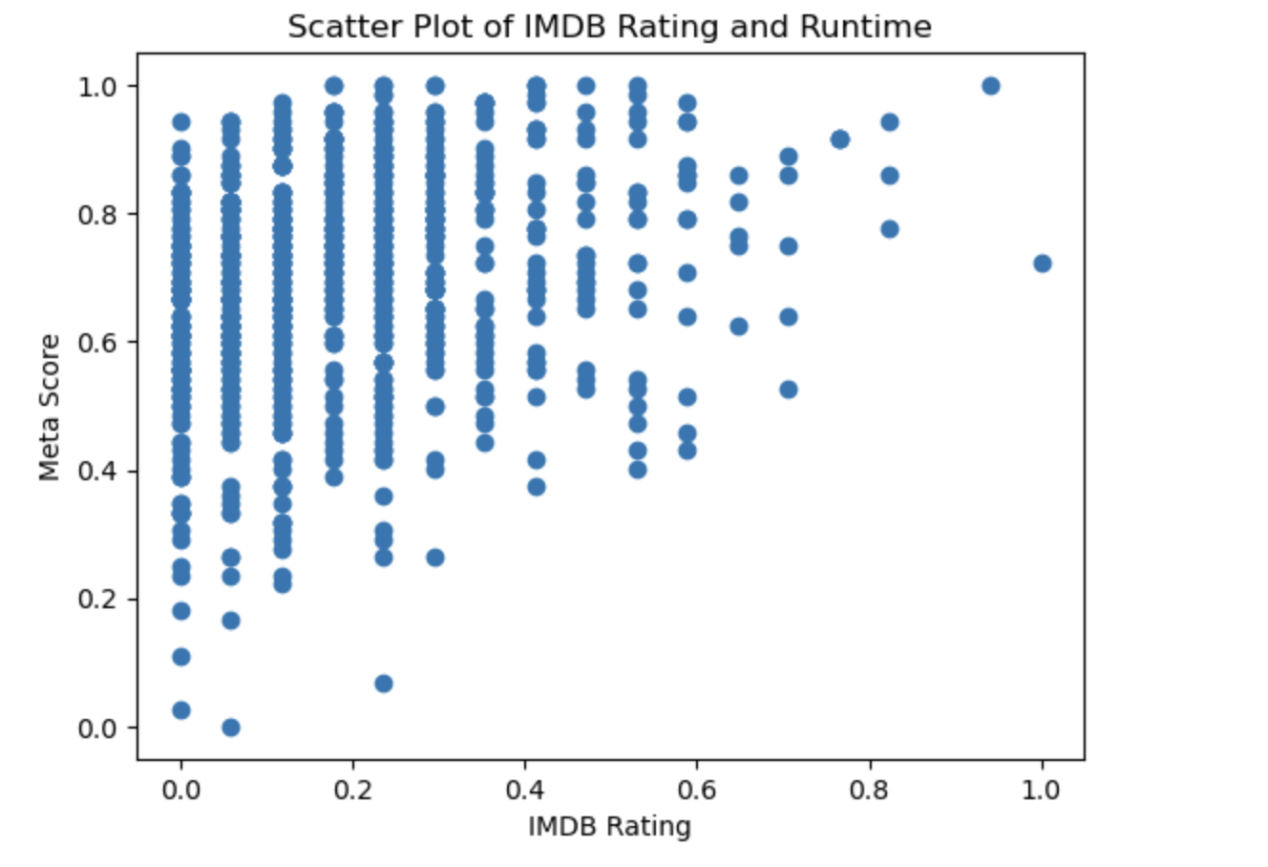
Correlation between columns(cont.)
Notes:
Moderately positive correlation between IMDB_Rating and Meta Score

Slide 7
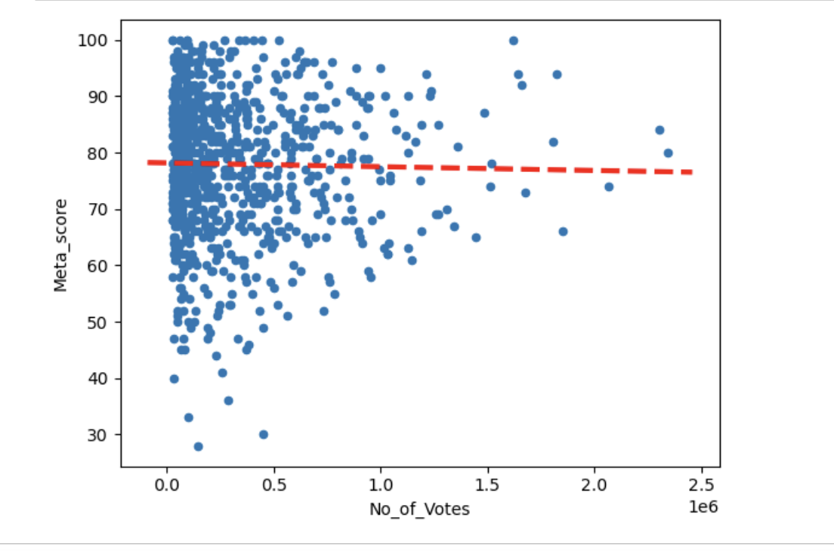
Linear Regression Model 1

Slide 8
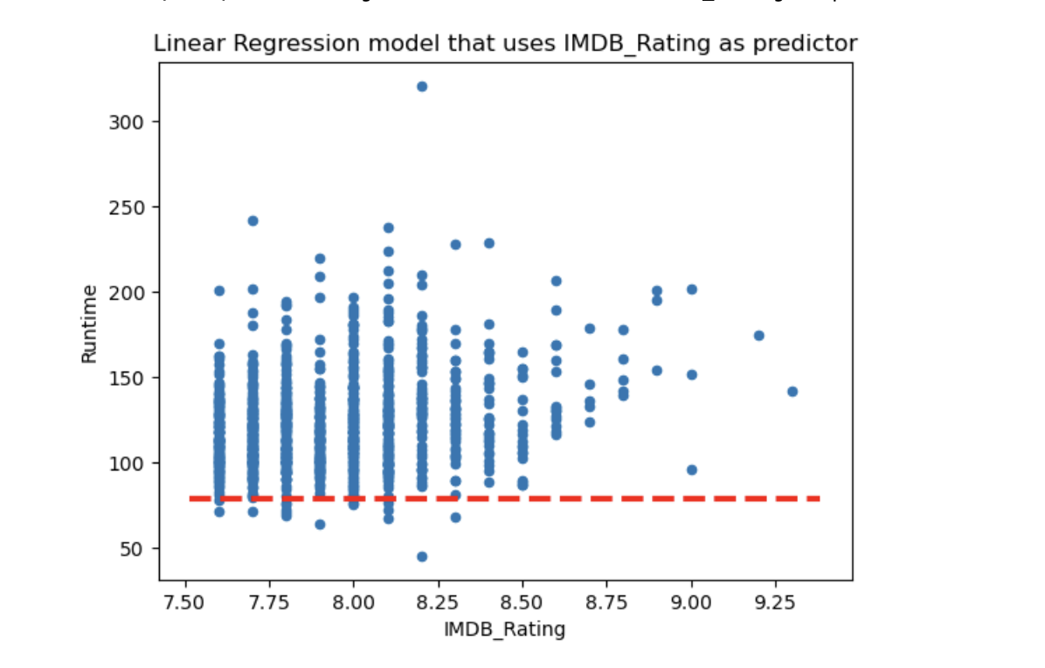
Linear Regression Model 2

Slide 9
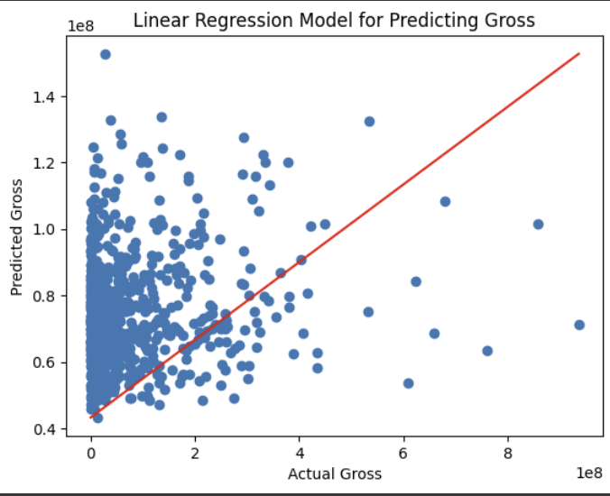
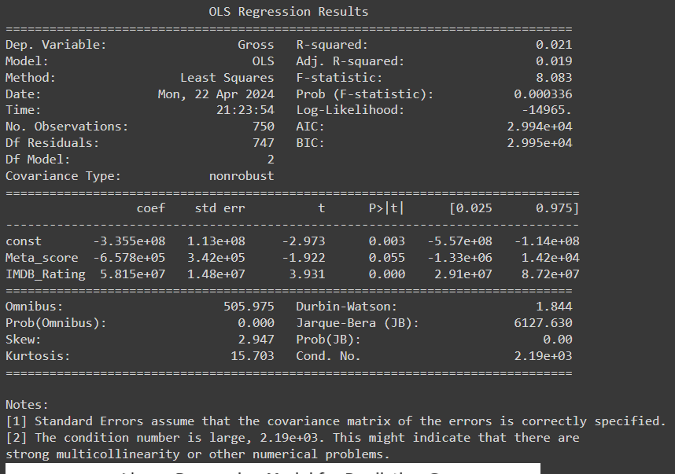
Linear Regression Model 3

Slide 10
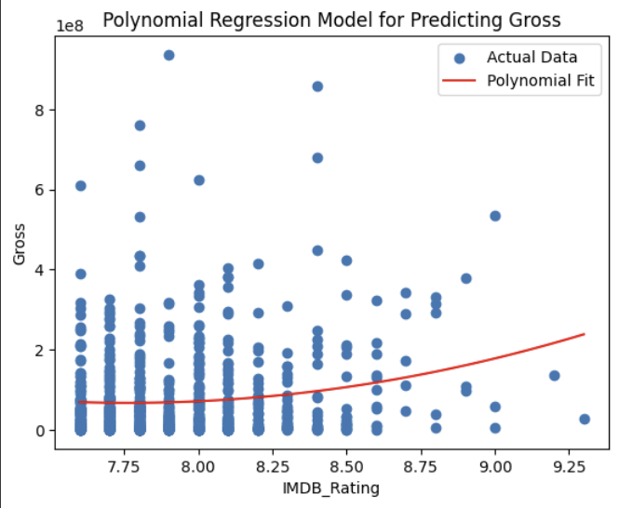
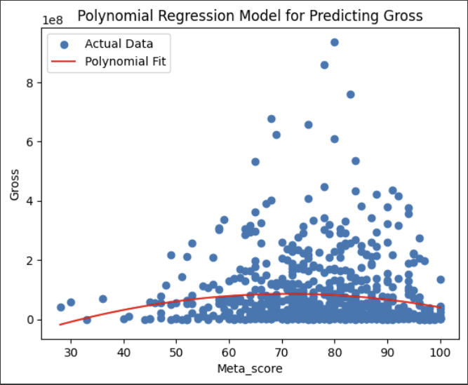
Polynomial Regression Models

Slide 11
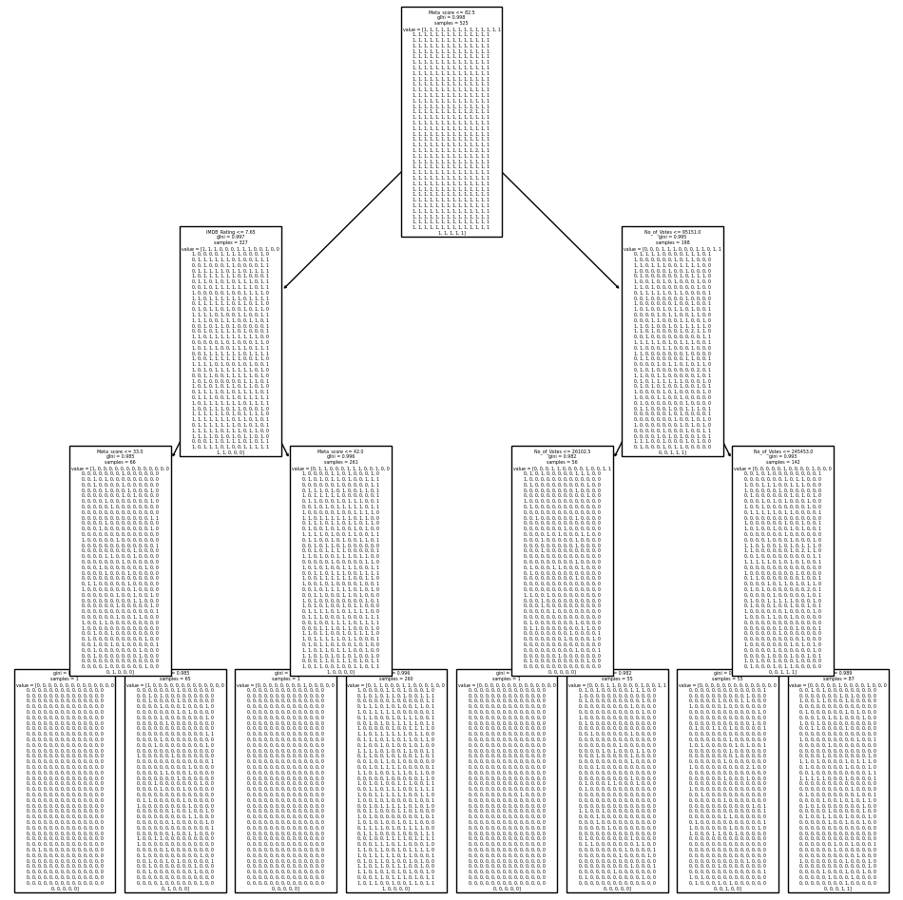
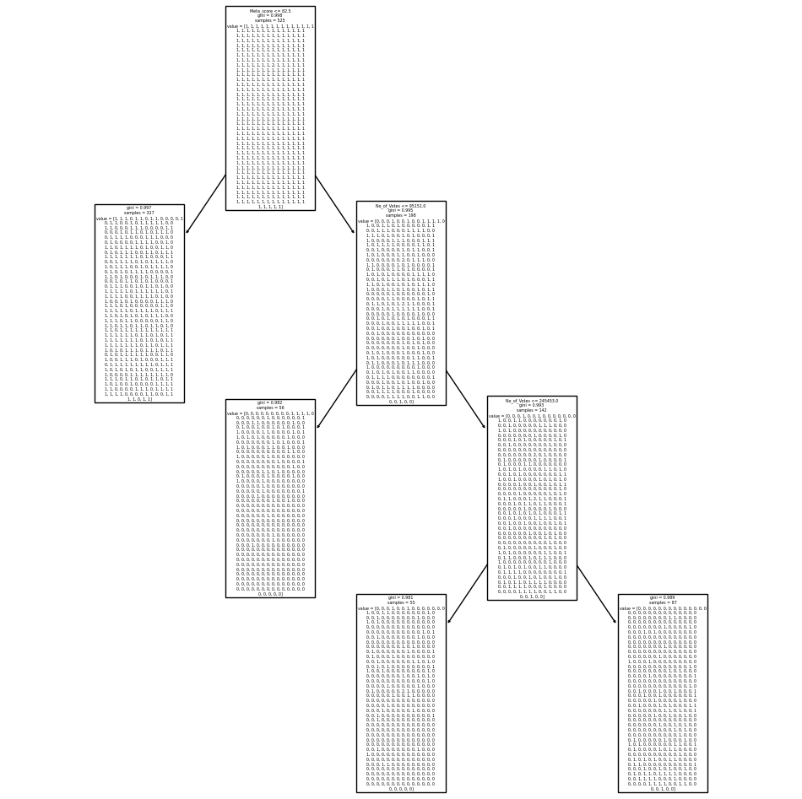
Regression Tree
Initial Regression Tree
Pruned Regression Tree
Notes:
As shown, these regression trees aren’t very pretty nor are they a good predictors. Looking at these regression trees are overwhelming, and we don’t really recommend using this for prediction in our data set. The regression tree tries to predict the gross revenue based off IMDB_Rating, Meta_score and No_of_Votes. To describe this regression tree, at the root, it starts off with a condition with Meta_Score, then followed by the other parameters. The values represents the distribution of target values (or the predicted outcome variable) in this node. From our analysis, the test set mean square error (MSE for short) for this regression tree was about 1.98*10^16, which is a very big MSE. A large MSE usually means a poor predictive performance. This was just one of the challenges we had to face, and it couldn’t really be solves due to the nature of the dataset. In retrospect, we could have made the regression tree more accurate by lowering the scope of the data along with some of the parameters such as No_of_Votes can be seen as “unnecessary”. –Note– We tried to do a classification tree, however, it was difficult having multiple categorical data, i.e., actors and directors, and somehow relating them to the gross revenue. When we attempted to do this, the classification tree did not look right. Given more attention and time, we might have been able to create a classification that could potentially predict the data well.

Slide 12
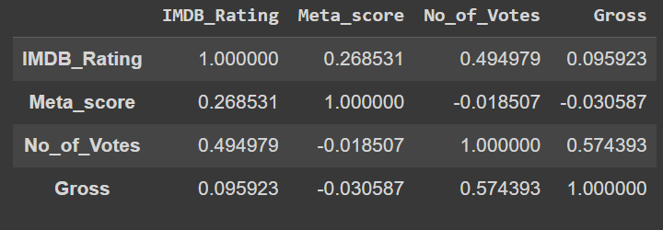
What worked best?
Correlation Matrix of numerical variables
No models worked well
Data is unpredictable
Very little noticeable trends to predict Gross income

Slide 13
Conclusion
Unable to figure out the best predictor for making a top movie
Used correlation/regression methods to analyze data
Could have used other methods (like classification)
Considered only quantitative data
Directors and Gross profit could have given us different insight

Slide 14
Thank You

